Slide 1


Salary Prediction: Linear vs. Polynomial Regression
In today's competitive job market, accurately predicting employee salaries is crucial for both HR departments and businesses. This presentation explores the use of linear and polynomial regression models to predict employee salaries based on their level within an organization. We will analyze the strengths and limitations of each model, examine their performance on a real-world dataset, and discuss practical implications for making informed salary decisions.

Slide 2


The Problem of Salary Prediction
Determining the appropriate salary for a new employee is a common challenge faced by HR departments. Traditionally, salary decisions are based on factors like experience, skills, and job market trends. However, these methods can be subjective and prone to biases.
1
Objective Accuracy
The need for a more objective and data-driven approach to salary prediction is essential for fairness, transparency, and competitive advantage.
2
Eliminating Biases
By leveraging statistical models like linear and polynomial regression, we can reduce subjective biases and ensure that salary offers are based on quantifiable factors.
3
Data-Driven Decisions
Data-driven salary prediction provides a solid foundation for making informed decisions regarding employee compensation, allowing for better budgeting and talent management.

Slide 3
Dataset and Feature Engineering
For this analysis, we used a real-world dataset containing information on various employee roles, including their job title, level within the company, and corresponding salary. This data was carefully curated and preprocessed to ensure data integrity and accuracy.
Job Title
Level
Salary
The "Position" column represents the job title of each employee, providing context for their role and responsibilities.
The "Level" column assigns a numerical ranking to each position, reflecting the hierarchical structure of the organization.
The "Salary" column represents the annual income for each employee at their respective level. It provides the target variable for our regression models.
Examples include "Business Analyst", "Software Engineer", and "Senior Manager."
Levels typically range from 1 for entry-level positions to 10 for the most senior roles.
Salary data was collected from reliable sources and adjusted for inflation and other factors.

Slide 4

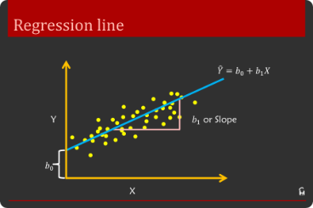
Linear Regression: A Simple Approach
Linear regression is a widely used statistical method that assumes a linear relationship between the independent variable (employee level) and the dependent variable (salary).
1
2
3
Step 1: Data Exploration
Step 2: Model Training
Step 3: Predictions and Evaluation
Begin by visualizing the relationship between employee level and salary using a scatter plot. This will help identify any potential trends or outliers.
Train a linear regression model using the dataset. The model learns the linear relationship between level and salary, represented by a straight line.
Use the trained model to predict salaries for new employees based on their level. Evaluate the model's performance using metrics like R-squared and mean squared error.

Slide 5





Polynomial Regression: Capturing Non-Linearity
While linear regression assumes a straight-line relationship, polynomial regression allows for more complex, non-linear relationships between variables. This approach is often more appropriate when salary growth isn't constant but rather accelerates or decelerates at different levels.
Understanding Non-Linearity
Polynomial Regression
Degree of the Polynomial
In real-world scenarios, salary increases may not be linear. For example, senior-level positions often command significant salary jumps compared to lower levels.
Polynomial regression uses a polynomial equation to model the curved relationship between level and salary, providing a more accurate representation.
The degree of the polynomial (e.g., quadratic, cubic, etc.) determines the complexity of the curve. A higher degree allows for more flexibility but can lead to overfitting.

Slide 6

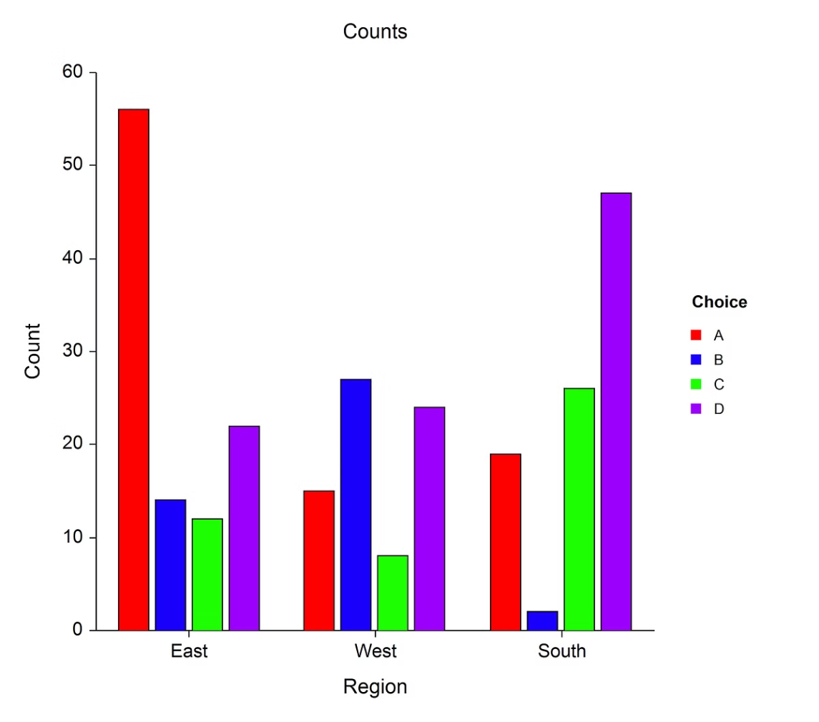
Model Evaluation and Comparison
After training both linear and polynomial regression models, it's essential to evaluate their performance on unseen data to determine which model provides the most accurate predictions. We used common metrics like R-squared (R²) and Mean Squared Error (MSE) for this purpose.
Metric
Linear Regression
Polynomial Regression
R²
0.669
0.997
MSE
1,289,687,878.79
145,917.04
The results demonstrate that the polynomial regression model significantly outperforms the linear regression model in terms of both R² and MSE, indicating a much better fit to the data.

Slide 7




Predicting Salaries for New Employees
To illustrate the practical application of these models, let's consider a hypothetical scenario where a new employee applies for a Regional Manager position with 2 years of experience. Based on our dataset, we can assign this employee a level of 6.5.
Linear Regression Prediction
Using the linear regression model, the predicted salary for this employee would be approximately $330,378.79.
Polynomial Regression Prediction
The polynomial regression model, on the other hand, predicts a salary of $158,862.45. This prediction is more realistic and aligns with the non-linear salary progression observed in our dataset.

Slide 8


Conclusion and Future Directions
Our analysis reveals that while linear regression provides a simple approach to salary prediction, polynomial regression can capture complex, non-linear relationships, resulting in more accurate predictions for employees at different levels. This insight is valuable for HR professionals, recruiters, and business leaders seeking to establish fair and data-driven compensation strategies.
Continuous Improvement
Model Optimization
Real-time Implementation
Further improvements to the models can be made by incorporating additional features, such as years of experience, location, and performance reviews, to enhance predictive accuracy.
Ongoing optimization of the polynomial regression model, particularly by fine-tuning the degree of the polynomial, can lead to even better model performance.
Integrating these models into HR software solutions can enable real-time salary predictions, streamlining the hiring process and ensuring fair compensation for all employees.

